Slide 1

Relation and Event Extraction

Slide 2
Contents
Introduction to Relation Extraction
Types of Relations
Approaches to Relation Extraction
Introduction to Event Extraction
Event Types
Applications of Relation and Event Extraction

Slide 3
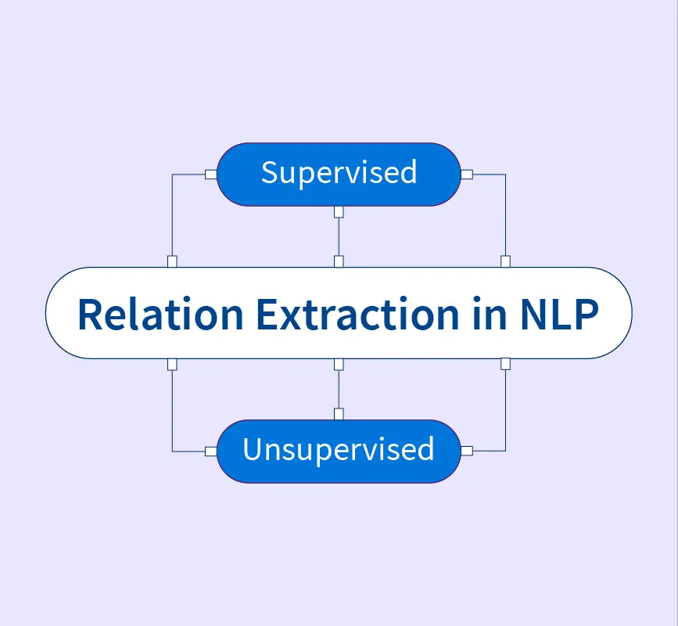
Introduction to Relation Extraction
Relation extraction is the process of identifying and classifying the relationships that exist between entities mentioned in text.
Entities can be people, organizations, locations, or any other named entities, and the goal is to extract the connections or associations between them.

Slide 4
Introduction to Relation Extraction
Significance in Information Retrieval and Knowledge Base Population
  Information Retrieval
    Relation extraction contributes to the organization and retrieval of information from text.
    By identifying relationships between entities, search engines can provide more relevant results.
    For instance, if a user searches for "CEO of Apple," relation extraction can help retrieve accurate information about the relationship between the entity "Apple" and the entity "CEO."
  Knowledge Base Population
    Relation extraction is crucial for building and populating knowledge bases, which are structured repositories of information about entities and their relationships.
    By automatically extracting relations from text, knowledge bases can be enriched with up-to-date and diverse information.
    This is particularly useful in domains like medicine, where extracting drug-disease relationships from research articles can contribute to drug discovery and healthcare.
  Text Summarization and Analysis
    Relation extraction can aid in summarizing large amounts of text by focusing on the most important relationships between entities.
    This is valuable for generating concise summaries of news articles, research papers, and other textual content.

Slide 5
Introduction to Relation Extraction
Significance in Information Retrieval and Knowledge Base Population
  Question Answering
    Relation extraction supports question-answering systems by enabling them to find specific answers based on the relationships between entities.
    When users ask questions about relationships ("Who is the spouse of Barack Obama?"), relation extraction helps identify the relevant information.
  Business Intelligence
    In the business domain, relation extraction can help uncover connections between companies, products, executives, and other entities.
    This information is valuable for market analysis, competitive intelligence, and decision-making.
  Social Network Analysis
    Relation extraction can be applied to analyze social media content, identifying relationships between users, organizations, and events.
    This supports tasks such as sentiment analysis, influence mapping, and trend prediction.

Slide 6
Types of Relations
Binary Relations
Binary relations involve two entities and represent a connection or association between them.
These are the most common types of relations extracted from text.
Examples of binary relations include:
"works at" (Employee works at Company)
"born in" (Person is born in Location)
"married to" (Person is married to Person)
Ternary Relations
Ternary relations involve three entities and capture more complex relationships.
These relations often represent interactions or associations that require multiple entities to fully describe.
Examples of ternary relations include:
"teaches" (Teacher teaches Subject to Student)
"has role in" (Actor has role in Movie as Character)
"involved in" (Person is involved in Event as Role)
N-ary Relations
N-ary relations involve more than three entities and are even more complex than ternary relations.
They capture intricate interactions among multiple entities.
Examples of N-ary relations include complex scenarios like supply chain networks, organizational hierarchies, and event participation involving multiple participants.

Slide 7
Approaches to Relation Extraction
Rule-Based Methods
  Rule-based approaches rely on predefined patterns and linguistic rules to extract relations.
  These rules are crafted based on syntactic and lexical patterns that are indicative of specific relationships.
  While rule-based methods can be effective for capturing certain well-defined relations, they may struggle with handling complex, varied, or ambiguous sentence structures.

Slide 8
Approaches to Relation Extraction
Supervised Methods
  Supervised methods involve training machine learning classifiers using annotated data.
  Annotated data consists of text samples where relationships between entities are labeled.
  Features like word embeddings, part-of-speech tags, and syntactic parses are used to train models like Support Vector Machines (SVMs), neural networks, or decision trees.
  These models learn to distinguish between different types of relations.
  While powerful, supervised methods require a significant amount of labeled training data.

Slide 9
Approaches to Relation Extraction
Unsupervised Methods
  Unsupervised methods do not rely on labeled data and instead explore patterns in the data itself.
  Clustering techniques group similar entities together, potentially indicating relationships.
  Co-occurrence and distributional similarity measures can also identify entities that frequently appear together, suggesting potential relations.
  Unsupervised methods are particularly useful when labeled data is scarce.

Slide 10
Approaches to Relation Extraction
Semi-Supervised Methods
  Semi-supervised methods combine elements of supervised and unsupervised approaches.
  They utilize a limited amount of labeled data along with a larger amount of unlabeled data.
  These methods leverage the labeled data to guide the unsupervised learning process and improve relation extraction accuracy.

Slide 11
Approaches to Relation Extraction
Deep Learning Approaches
  Deep learning techniques, such as neural networks and transformers, have been applied to relation extraction.
  These models can capture complex contextual information and learn hierarchical representations, making them effective for handling various sentence structures and ambiguous cases.

Slide 12
Introduction to Event Extraction
Event extraction is the process of identifying events mentioned in text and extracting relevant information about those events, including the actions or occurrences described and the entities participating in those events.
Events and Their Components
  Events are instances of actions, occurrences, or situations that take place in the world.
  They encompass a wide range of activities, from simple actions like "running" to more complex occurrences like "elections" or "earthquakes."
  Events often involve multiple entities that play various roles within the event context.
  For example, in the event "John bought a book," "bought" is the action, "John" is the agent (participant performing the action), and "book" is the theme (participant being affected by the action).

Slide 13
Introduction to Event Extraction
Significance of Event Extraction
  Event extraction is crucial for understanding the narrative and context of a text, as events are central to the stories, information, and relationships conveyed.
  By identifying and extracting events and their participants, information retrieval systems can provide users with relevant information about actions, occurrences, and the entities involved.
  Additionally, event extraction plays a significant role in populating knowledge bases with structured information, facilitating information retrieval, question answering, and various applications in fields like news analysis, social media monitoring, and more.

Slide 14
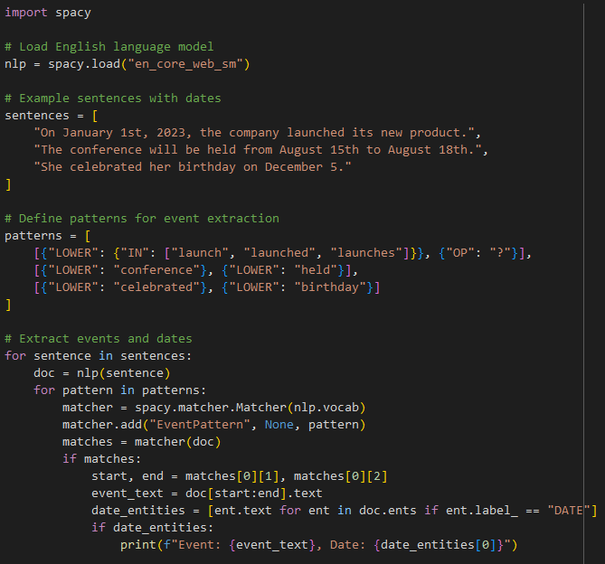
Introduction to Event Extraction
Example
In this example:
We load the English language model using spacy.load("en_core_web_sm").
We provide example sentences that may contain event-related information.
We define patterns using spaCy's rule-based matching to extract specific event-related phrases.
We iterate through the sentences, apply the patterns, and use the Matcher to identify matches.
If a match is found, we identify the corresponding date entities (recognized by the model) and print the event and date information.

Slide 15
Event Types
Simple Events
involve a single action or occurrence and the participants associated with that action.
These events are often described in a single sentence and can include verbs like "run," "eat," "talk," etc.
Examples of simple events include:
"Alice is baking a cake."
"The cat chased the mouse."
"The company announced its quarterly earnings."
Complex events
are more intricate and involve sequences of actions or causal relationships.
These events unfold over time and can span multiple sentences or paragraphs.
Examples of complex events include:
"The protest rally led to clashes between police and demonstrators."
"After finishing dinner, they went for a walk and then watched a movie."
"The earthquake caused widespread damage, followed by rescue efforts and relief
Causal Events
Causal events describe cause-and-effect relationships between actions or occurrences.
These events highlight the reasons or consequences of certain actions.
Causal events play a key role in understanding the flow of events and the motivations behind them.
Examples of causal events include:
"Due to heavy rain, the event was postponed."
"Her speech inspired a wave of enthusiasm among the audience."

Slide 16
Event Types
Temporal Events
Temporal events involve time-related relationships between actions or occurrences.
These events describe when events happen, in what order, or within what time frame.
Temporal events contribute to understanding the chronological sequence of events.
Examples of temporal events include:
"After breakfast, he went to work.“
"The conference will take place next month."
Transitive and Intransitive Events
Transitive events involve actions that transfer an effect from an agent to a theme (e.g., "Alice baked a cake").
Intransitive events involve actions that do not require a direct object (e.g., "She danced gracefully").
Attributive Events
Attributive events describe qualities or attributes of entities, often using verbs that express states or characteristics.
Examples include "is known for," "is famous for," and "is characterized by."

Slide 17
Applications
Knowledge Base Construction
  Relation extraction is essential for populating knowledge bases with structured information.
  It enables the creation of structured databases where entities are linked through extracted relationships.
  This structured data can be used for querying, analytics, and knowledge management.
Question Answering
  Relation and event extraction contribute to accurate question answering systems.
  By identifying relationships between entities and events, these systems can retrieve relevant information and answer user queries more effectively

Slide 18
Applications
Information Retrieval
  Extracted relations and events enhance search engines' ability to retrieve relevant documents and snippets.
  Improved understanding of relationships allows for more precise matching of user queries to relevant content.
News Analysis
  Relation and event extraction aid in analyzing news articles, identifying key events, and understanding how entities are connected in global events and stories.
Financial Analysis
  In the financial domain, event extraction helps track market movements, company announcements, mergers and acquisitions, and other significant events that impact financial markets.

Slide 19
Applications
Social Media Monitoring
  Relation and event extraction facilitate the analysis of social media content to identify trends, emerging topics, and sentiment around specific events.
Biomedical Research
  In the biomedical field, relation and event extraction contribute to the extraction of molecular interactions, drug-target relationships, and disease-gene associations from scientific literature.
Machine Reading Comprehension
  Event and relation extraction systems aid machines in comprehending and reasoning over textual information.
  They enable machines to understand complex narratives and answer questions about them.

Slide 20
Applications
Automated Summarization
  Extracted events and relationships can be used to generate concise and coherent summaries of longer texts, helping users quickly understand the main points.
Data Enrichment
  Relation and event extraction enhance data enrichment efforts by providing additional context and relationships to existing datasets.
Policy Analysis
  In policy analysis, relation and event extraction help understand the interactions between government actions, public sentiment, and societal outcomes.

Slide 21
Applications
Criminal Investigation
  In law enforcement, event and relation extraction aids in analyzing case narratives, identifying suspects, and connecting evidence to build a clearer picture of criminal activities.
Healthcare
  In the healthcare domain, relation extraction contributes to understanding medical events, drug interactions, patient histories, and treatment outcomes.
Sentiment Analysis and Opinion Mining
  Extracted events and relationships can provide context for sentiment analysis, enabling more accurate assessments of opinions and attitudes expressed in text.

Slide 22
Practice
Instructions
  In this assignment, you'll practice relation and event extraction using pattern matching and the spaCy library.
Tasks
  Task 1: Understanding Relation and Event Extraction
    Explain the concepts of relation extraction and event extraction in the context of natural language processing.
    Describe the importance of these tasks in information extraction and knowledge representation.
  Task 2: Pattern Matching for Relation Extraction
    Choose three example sentences that involve relationships (e.g., "John works at a company," "The cat chased the mouse," "Alice is married to Bob.").
    Define patterns for each type of relationship you want to extract (e.g., "PERSON works at ORG," "ANIMAL chased ANIMAL," "PERSON is married to PERSON").
    Implement pattern matching using the spaCy library to extract relationships from the sentences.

Slide 23
Practice
Tasks
  Task 3: Pattern Matching for Event Extraction
    Choose three example sentences that describe events (e.g., "The concert took place on Friday," "The team won the championship," "She celebrated her birthday on Saturday.").
    Define patterns for each type of event you want to extract (e.g., "EVENT took place on DATE," "TEAM won EVENT," "PERSON celebrated EVENT on DATE").
    Implement pattern matching using the spaCy library to extract events from the sentences.
  Task 4: Discussion and Reflection
    Discuss the challenges of relation and event extraction in real-world scenarios, including ambiguity and complex structures.
    Explain how pattern matching can be effective for simple cases but might struggle with capturing more nuanced relationships or events.

Slide 24
Q & A

